Slide 1
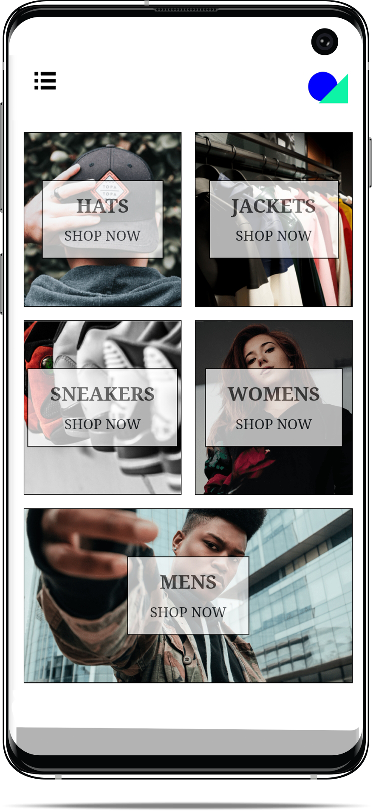
React Store App
by
Seaside Development
Pushing the envelope

Slide 2
AGENDA
Introduction
The Problem
Solution
App Portfolio
Features
Demo
What is Next
Questions

Slide 3
INTRODUCTION
We at Seaside cater to our client’s every need by providing them easy to use applications as well as supporting backend services to handle any task.
That’s the Seaside way

Slide 4

PROBLEM
SO, WHAT ARE WE TACKLING?
In Barbados, we find there is a lack of well-structured an optimized applications. Therefore, we want to get rid of that by making clean, elegant, multi-platform applications.
Many persons complain the apps are poorly laid out .
No web front apps due to high-cost of native development. This makes many small businesses shy away from the thought of creating feature rich web applications.
Poor choice of back-end services

Slide 5

SOLUTION
What we are offering: single code-based applications that resolve many issues due to high development cost
Easy to use
Integrated payment systems
Push notifications on IOS, Android and Web Platforms
Quickly Developable

Slide 6
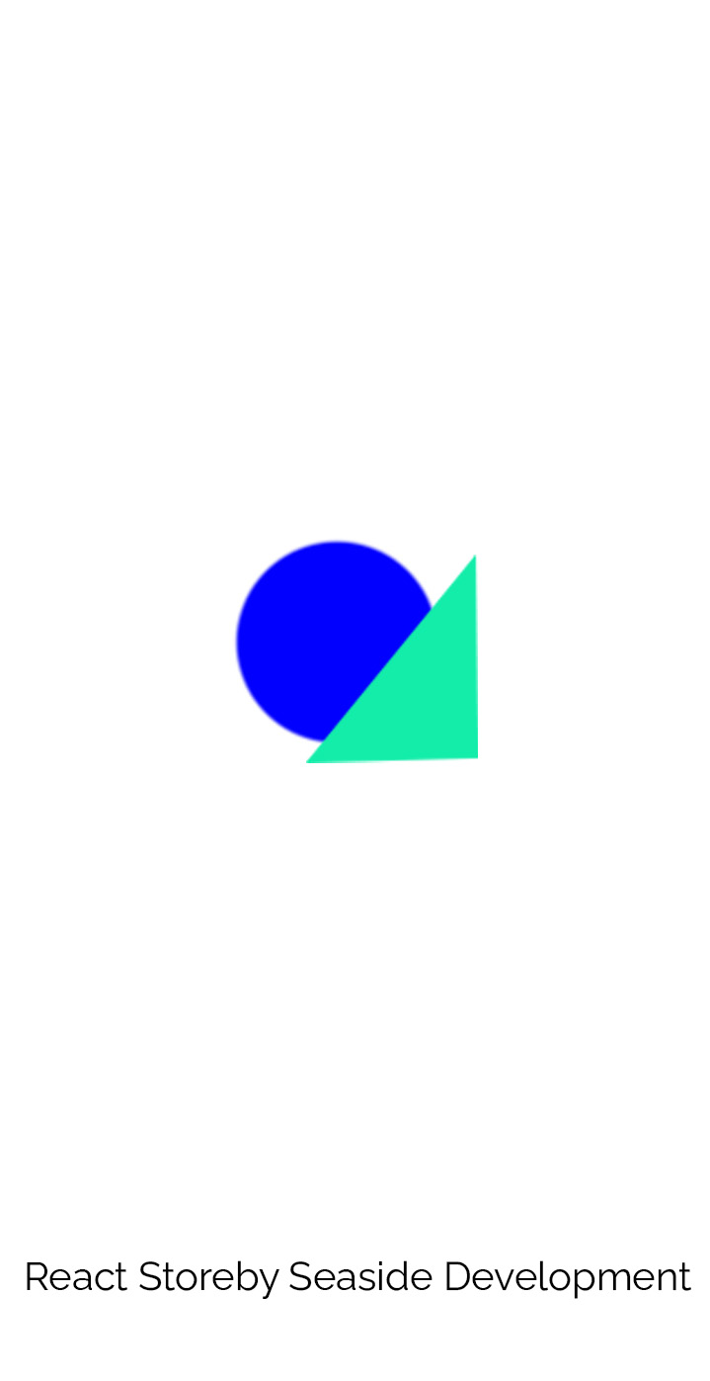
APP PORTFOLIO
Splash Screen
We can customize Splash screens to our client’s content
An Ecommerce App
Responsive
Integrate Payments
Secure
Back-end Services

Slide 7
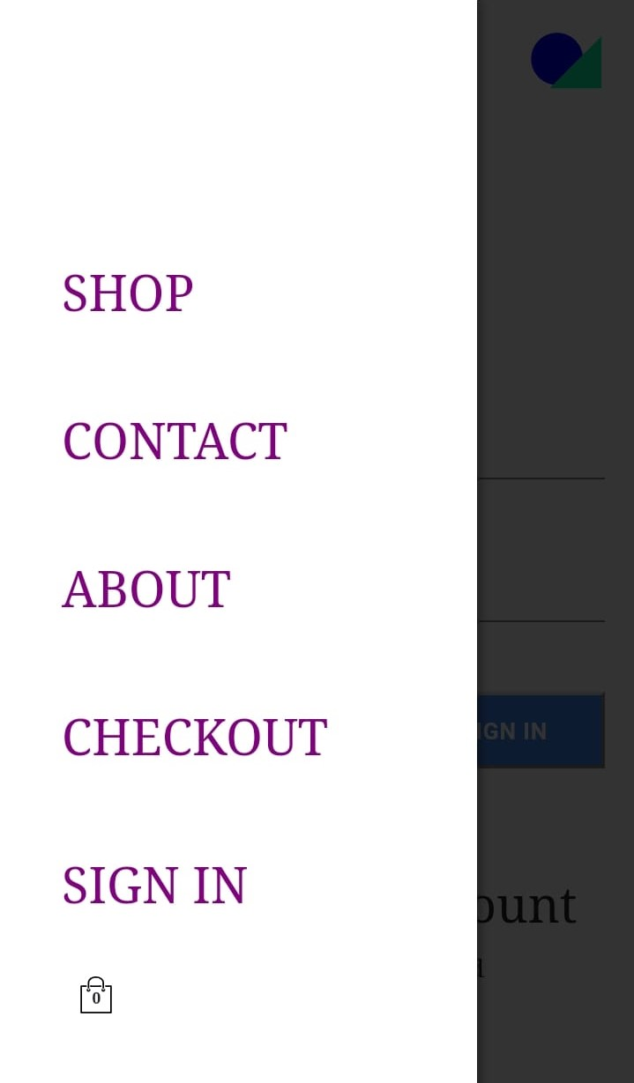
APP PORTFOLIO CONT’D
SIDE DRAWER - 01
An Easy-to-use interface
Quick Access other pages
Pages cached for faster speeds
Real time updates on cart activity

Slide 8
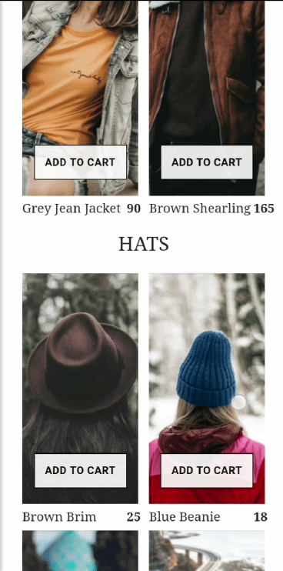
CONT’D
SHOP PAGE - 02
See Recently Added Items
Simple and easy to use
Large buttons for easy interaction
Let customers get a snapshot of site content

Slide 9
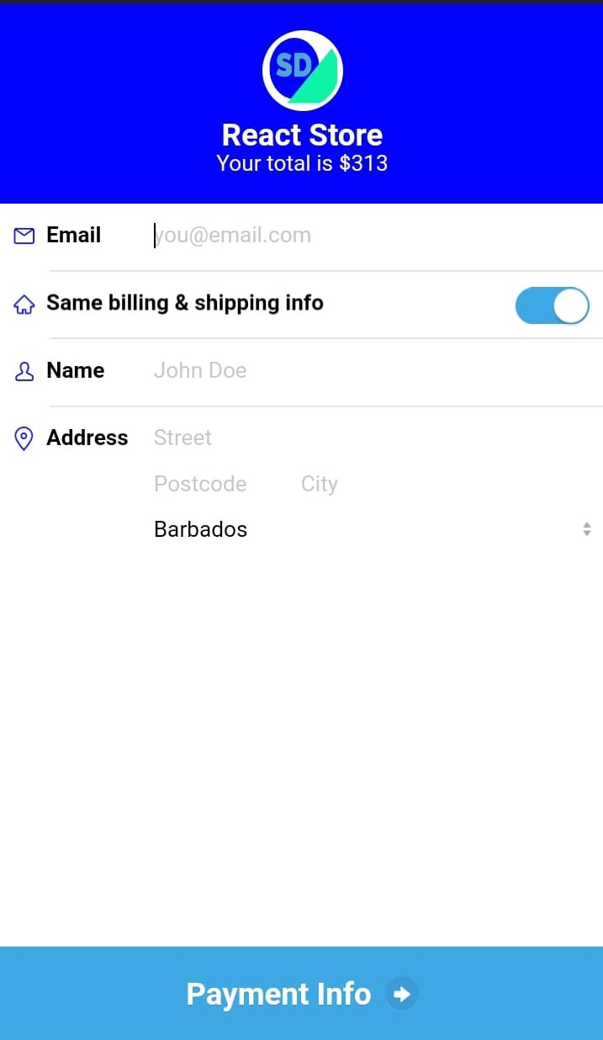
CONT’D
CHECK OUT PAGE - 03
Quick and Secure Payments
We leverage the use of Stripe API to handle the payment process of the client cart.
We have a cart icon that displays the amount in the cart and additionally allows the user to see the contents of the cart.

Slide 10
FEATURES
We want our client's app to work for them and for their end users
Push Notifications
Realtime Updates
Email Handling
Integrate Payments
User Authentication
Google Analytics

Slide 11
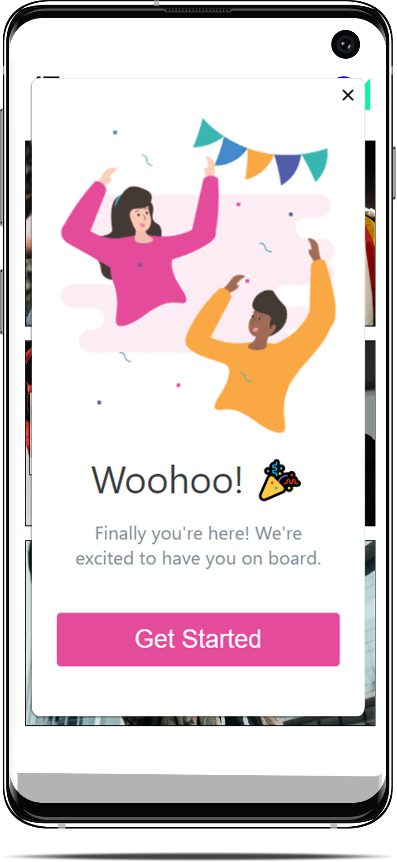
CONT’D
PUSH NOTIFCATIONS- 01
One Signal and Firebase Cloud Messaging
We leverage the use of One Signal to enable the client to send notifications to their end users
It allows for In App notifications. Great for greeting newcomers to the app

Slide 12
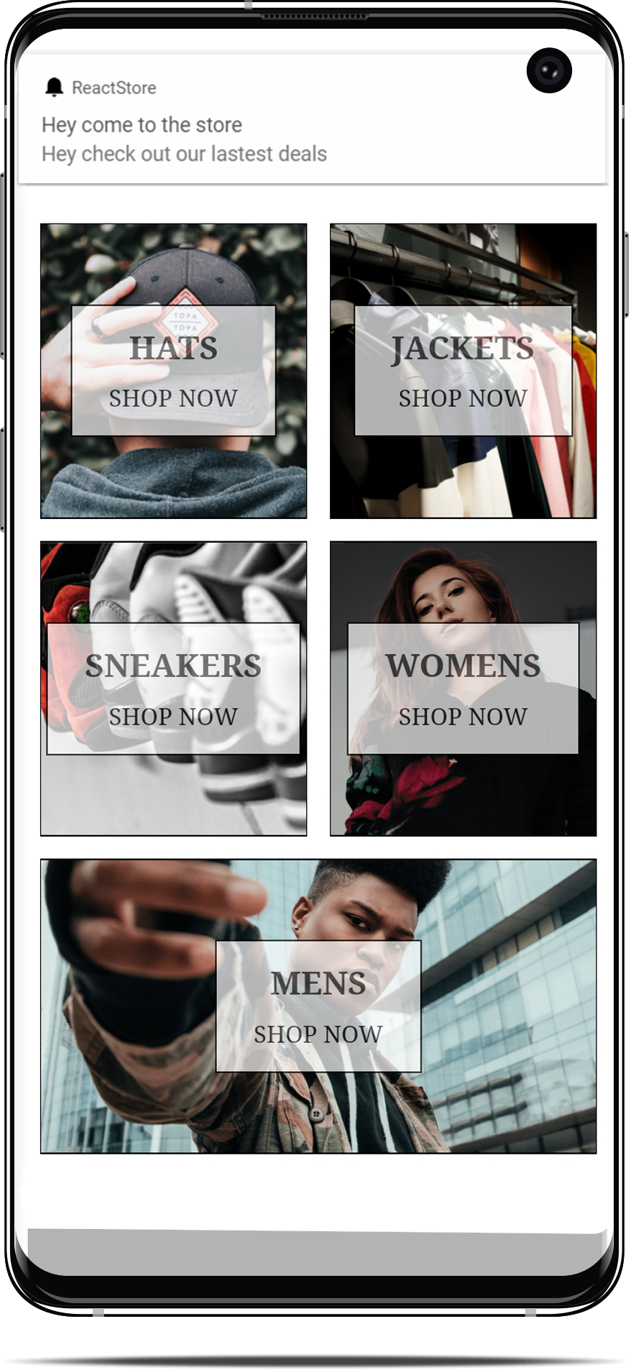
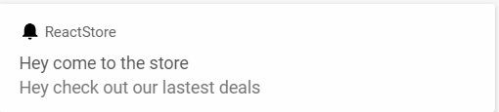
CONT’D
PUSH NOTIFCATIONS- 01.1
One Signal and Firebase Cloud Messaging
Traditional push notifications are great for reminding customers of anything relevant about the app or about their user account. i.e., empty cart or inactivity
Increasing app engagement
Get analytical data of engagements

Slide 13
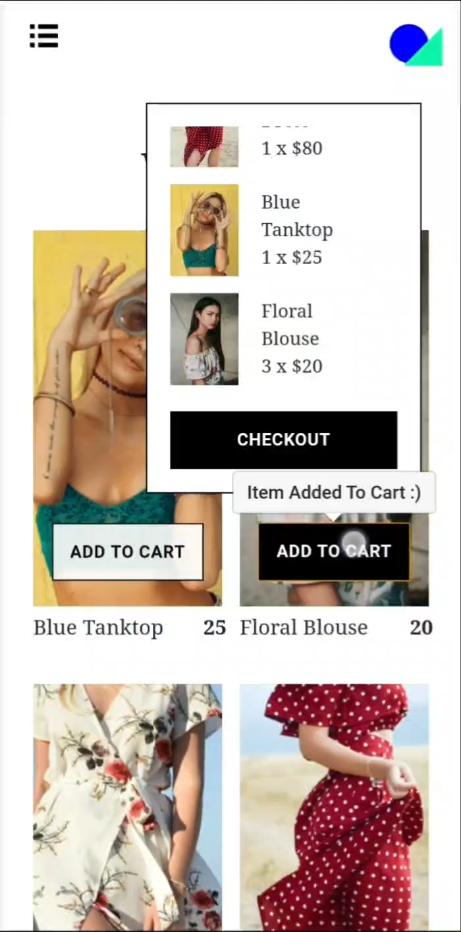
CONT’D
REALTIME UPDATES - 02
USING SESSION PERSISTENTS AND CLEVER CODING
Can store contents of cart even after user has left
Provide real time updates on the cart
Allow end users to adjust the cart in real-time

Slide 14
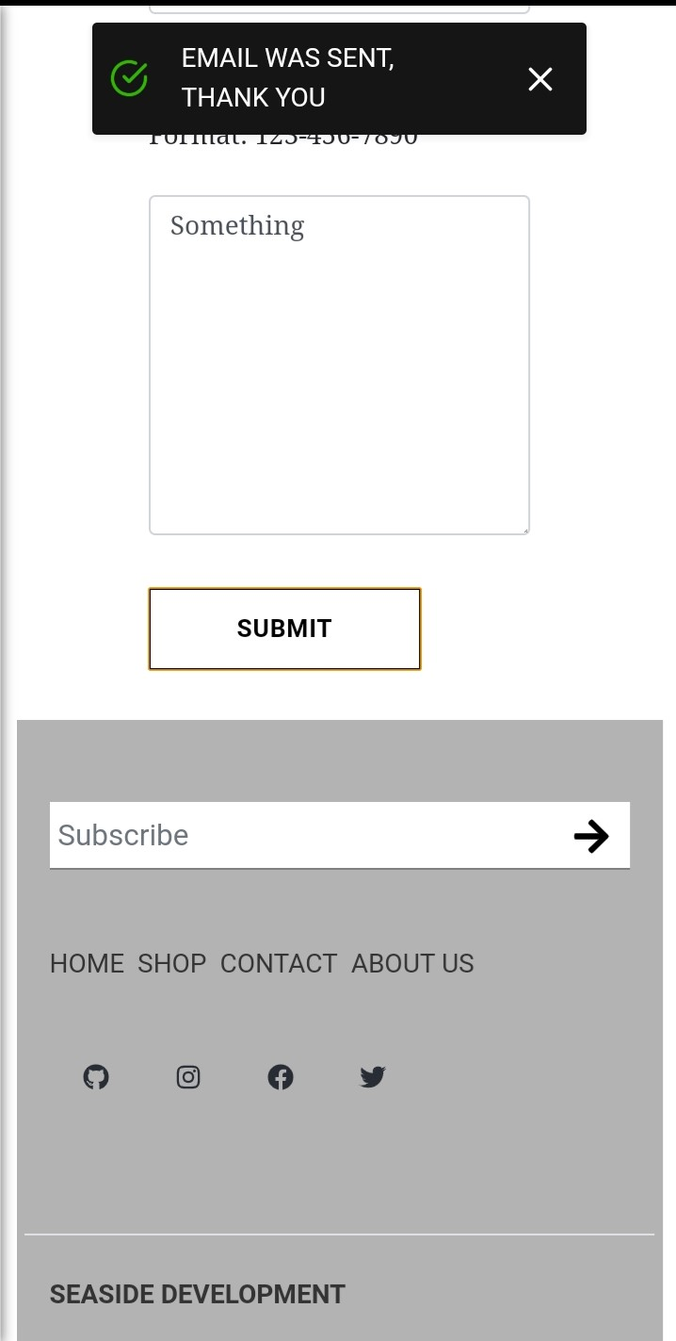
CONT’D
EMAIL HANDINGLING - 03
Taking Advantage Of The JavaScript Language We Used EMAIL JS To Handle The Emailing
Allows for a contact us page
Can add a subscription modal or input form
Quickly send emails from end user to client, vice versa

Slide 15
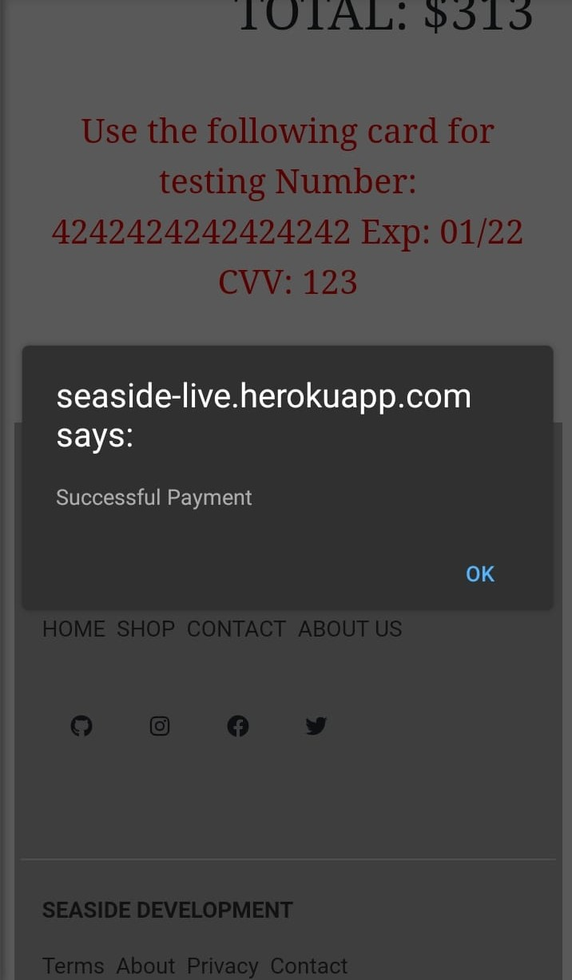
CONT’D
PAYMENT HANDINGLING - 04
By using the Stripe API, we can seamlessly integrate payments
Track payments made in the app
Can refund end users
Send notifications when payment is successful and errors for unsuccessful payments

Slide 16
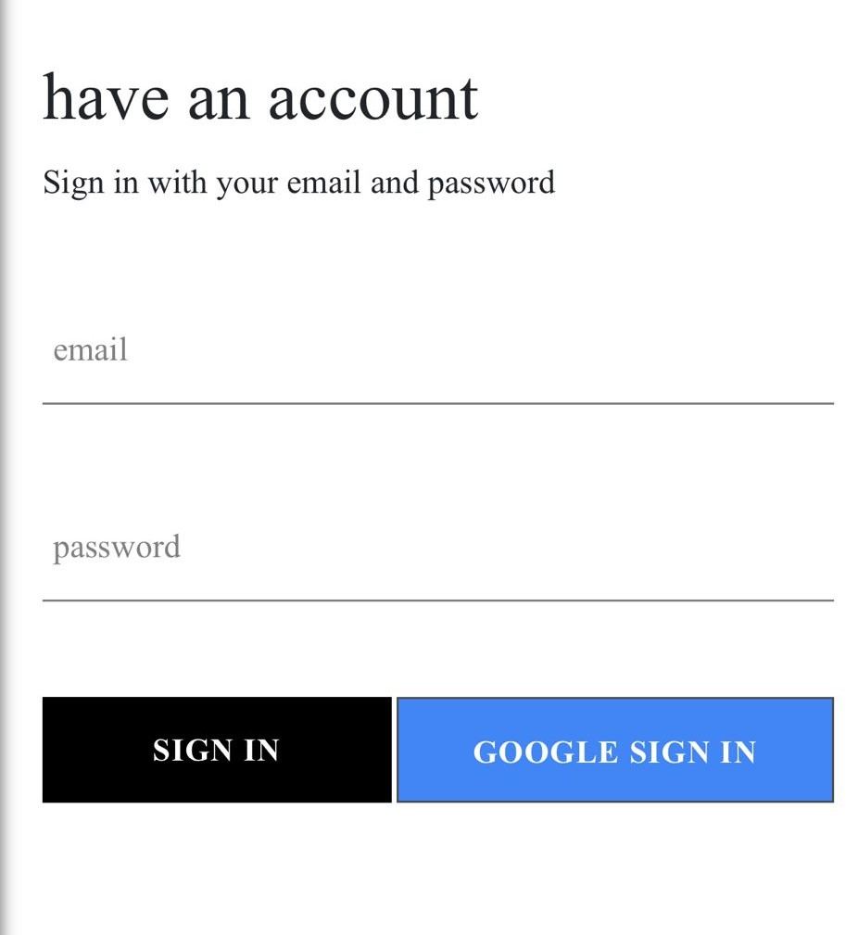
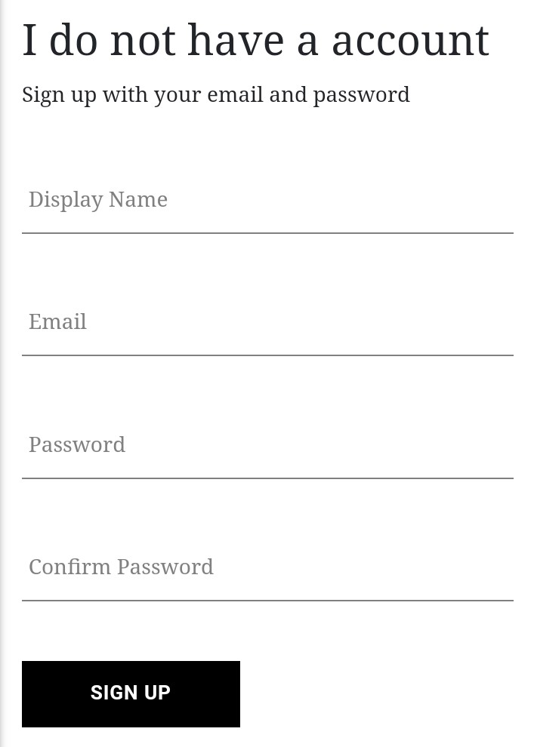
CONT’D
USER SIGN IN AND AUTHENTICATION - 05
We use the cloud service Firebase not just for data storage but for user Authentication
Allows for Google sign in
End users can sign up
Firebase has strong security protecting the store data

Slide 17
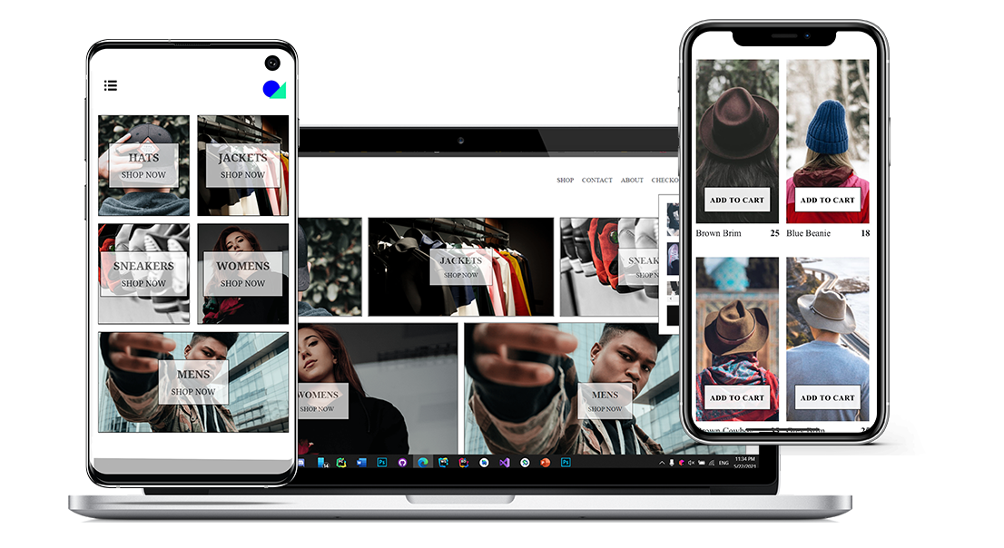
APPLICATION DEMO

Slide 18
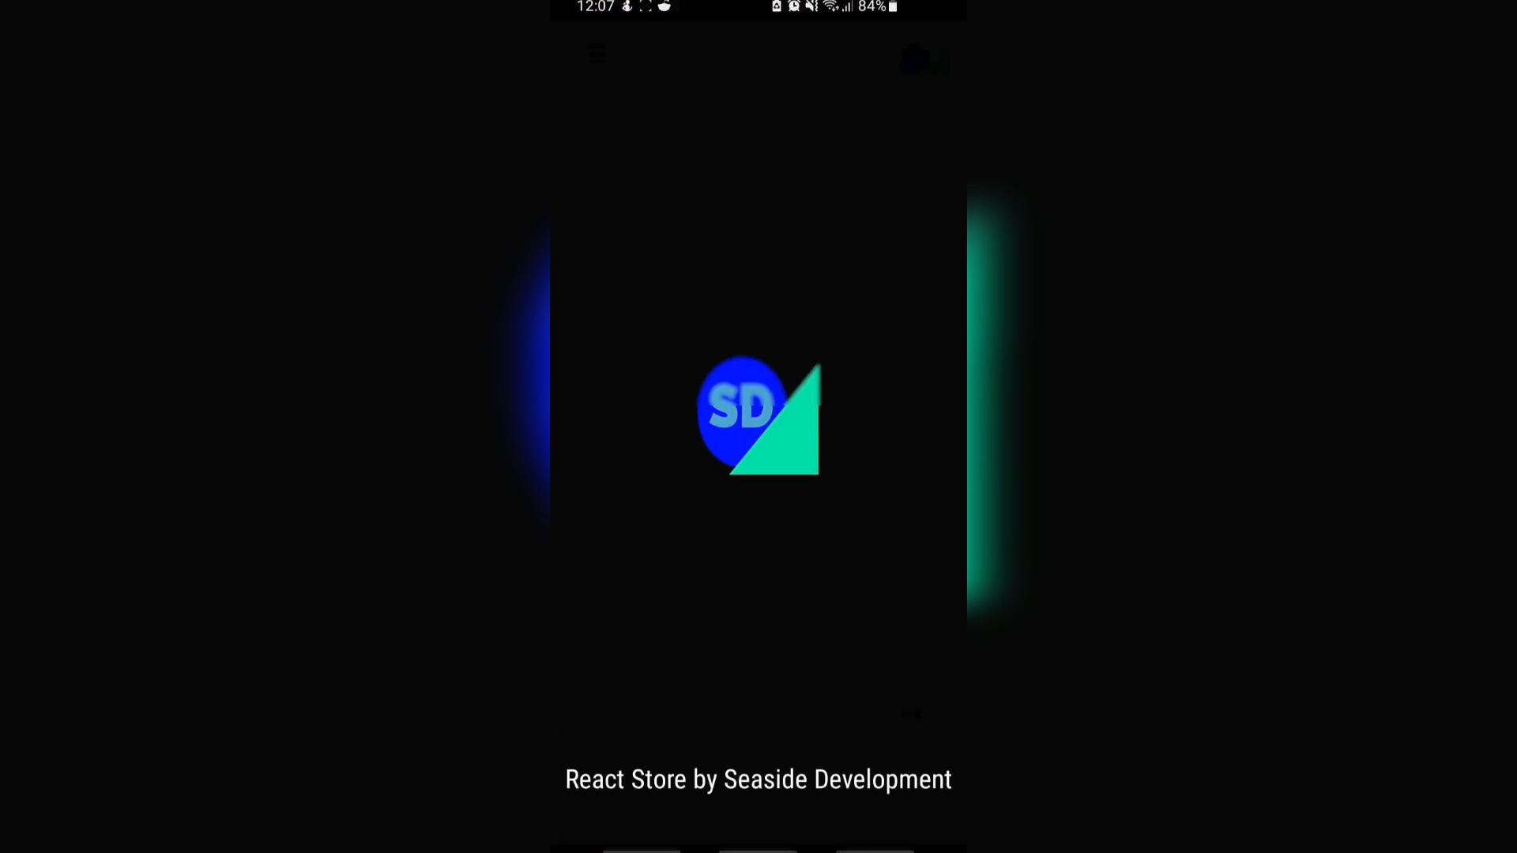
APP DEMO

Slide 19
WHAT NEXT?
We Want To Improve The Client And Their End User’s Experiences
We Hope To Create More Apps.
Further Cross Platform Capabilities
Use Of Better Security Metrics, Like Biometrics.
More Feature Rich Apps
Continue To Improve Client And End User Satisfaction.
Greater Use Of Storage To Optimize Offline Use

Slide 20
Questions?

